Slide 1
Misleading Digital Media Graphs

Slide 2
Intended Learning Outcome(ILO)
At the end of this lesson, students will be able to;
Identify misleading features in digital media graphs and explain how they can affect people’s interpretation of data.
Collaborate with their peers to analyze, discuss, and correct misleading graphs using appropriate statistical concepts.
Communicate their interpretation of statistical information clearly.

Slide 3
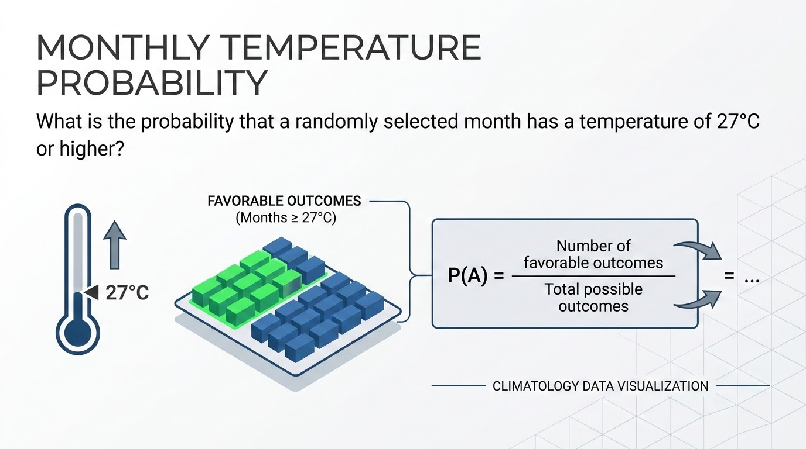

Slide 4
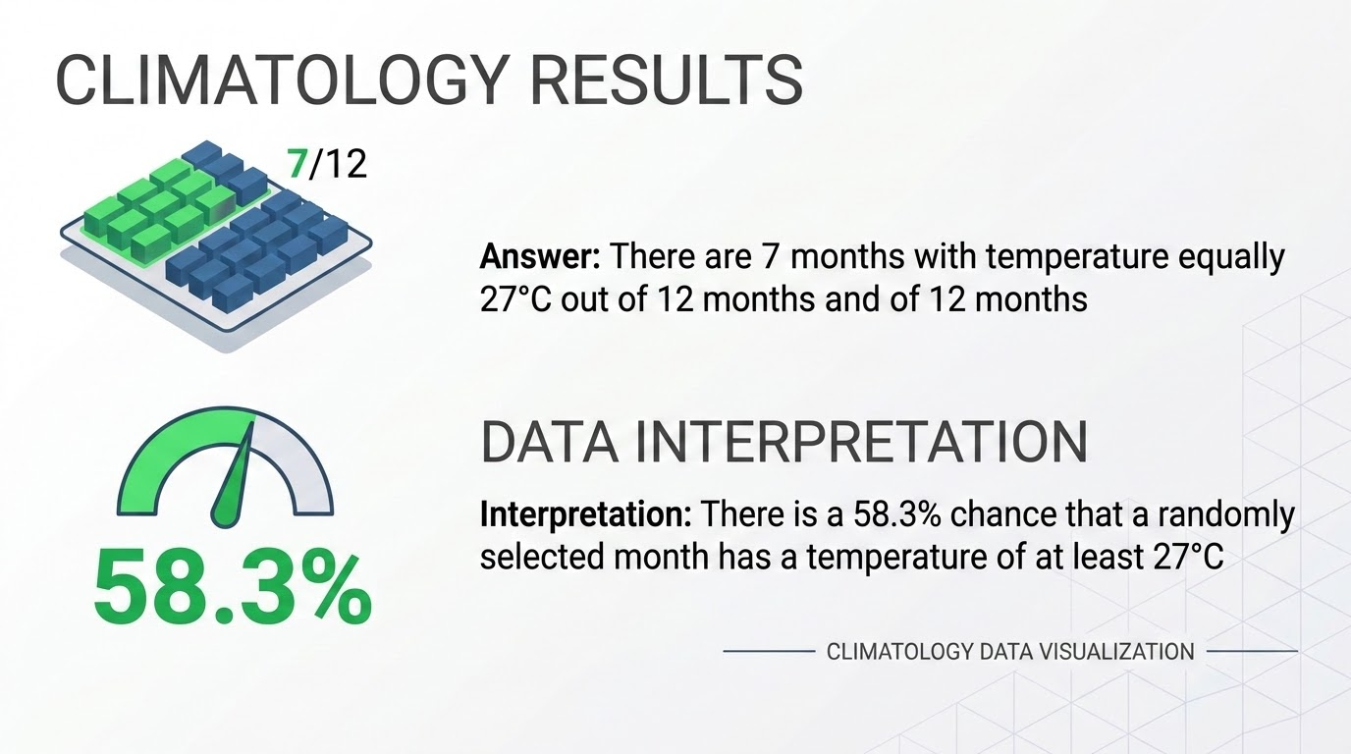

Slide 5
